Slide 1
Fractal Geometry Methods & Procedural Modelling
Natural objects can be realistically described using fractal geometry methods
Fractal methods use procedures rather than equations to model objects - procedural modelling
The major characteristic of any procedural model is that the model is not based on data, but rather on the implementation of a procedure following a particular set of rules
Modelling On The Fly!

Slide 2
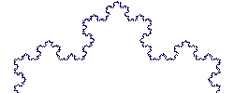
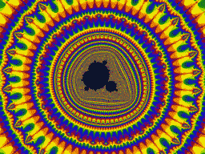
Fractals
A fractal object has two basic characteristics:
  Infinite detail at every point
  A certain self similarity between object parts and the overall features of the object
Mandelbrot Set Video From:
http://www.fractal-animation.net/ufvp.htm
The Koch Curve

Slide 3
Generating Fractals
A fractal object is generated by repeatedly applying a specified transform function to points in a region of space
If P₀ = (x₀, y₀, z₀) is a selected initial position, each iteration of a transformation function F generates successive levels of detail with the calculations:
In general the transformation is applied to a specified point set, or to a set of primitives (e.g. lines, curves, surfaces)

Slide 4
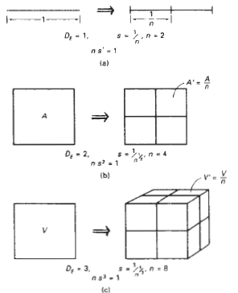
Generating Fractals
Relationships between the scaling factor s; and the number of subparts n for subdivision of a unit straight-line segment, A square, and a cube

Slide 5
Fractal Dimension
If take a line segment having length L and divide it into n pieces each piece having length ‘l’, The scaling factor s1 = 1/n
we get original segment back by scaling a segment by S
n = s^{1 where s = 1/s1}
Similarly, a square is divided into four equal-area subparts by s₁ = 0.5
n = 4 and s = 1/s₁ = 2 so n = s^{2 or} 4 = 2²
A cube is divided into eight equal-volume subparts n = s³
Here, 1,2,3 are dimension of object , the relationship between the number of subparts and the scaling factor is n = s^{D}
Solving this expression for D, the fractal similarity dimension, we have
D = ( log n) / ( log s)

Slide 6
Generating Fractals (cont…)
Although fractal objects, by definition have infinite detail, we only apply the transformation a finite number of times
Obviously objects we display have finite dimension – they fit on a page or a screen
A procedural representation approaches a true representation as we increase the number of iterations
The amount of detail is limited by the resolution of the display device, but we can always zoom in for further detail

Slide 7
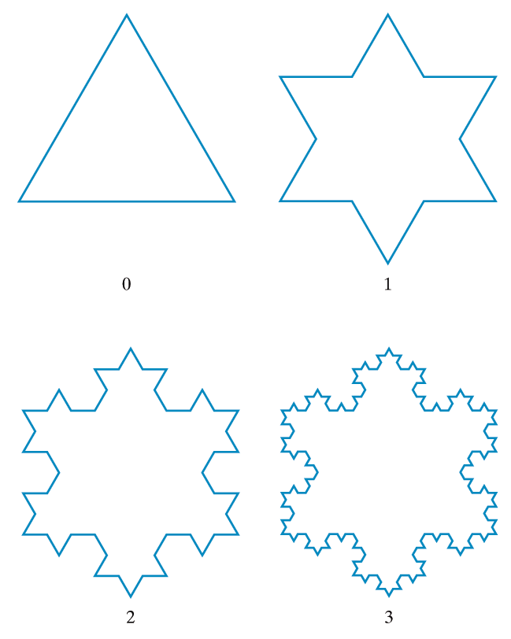
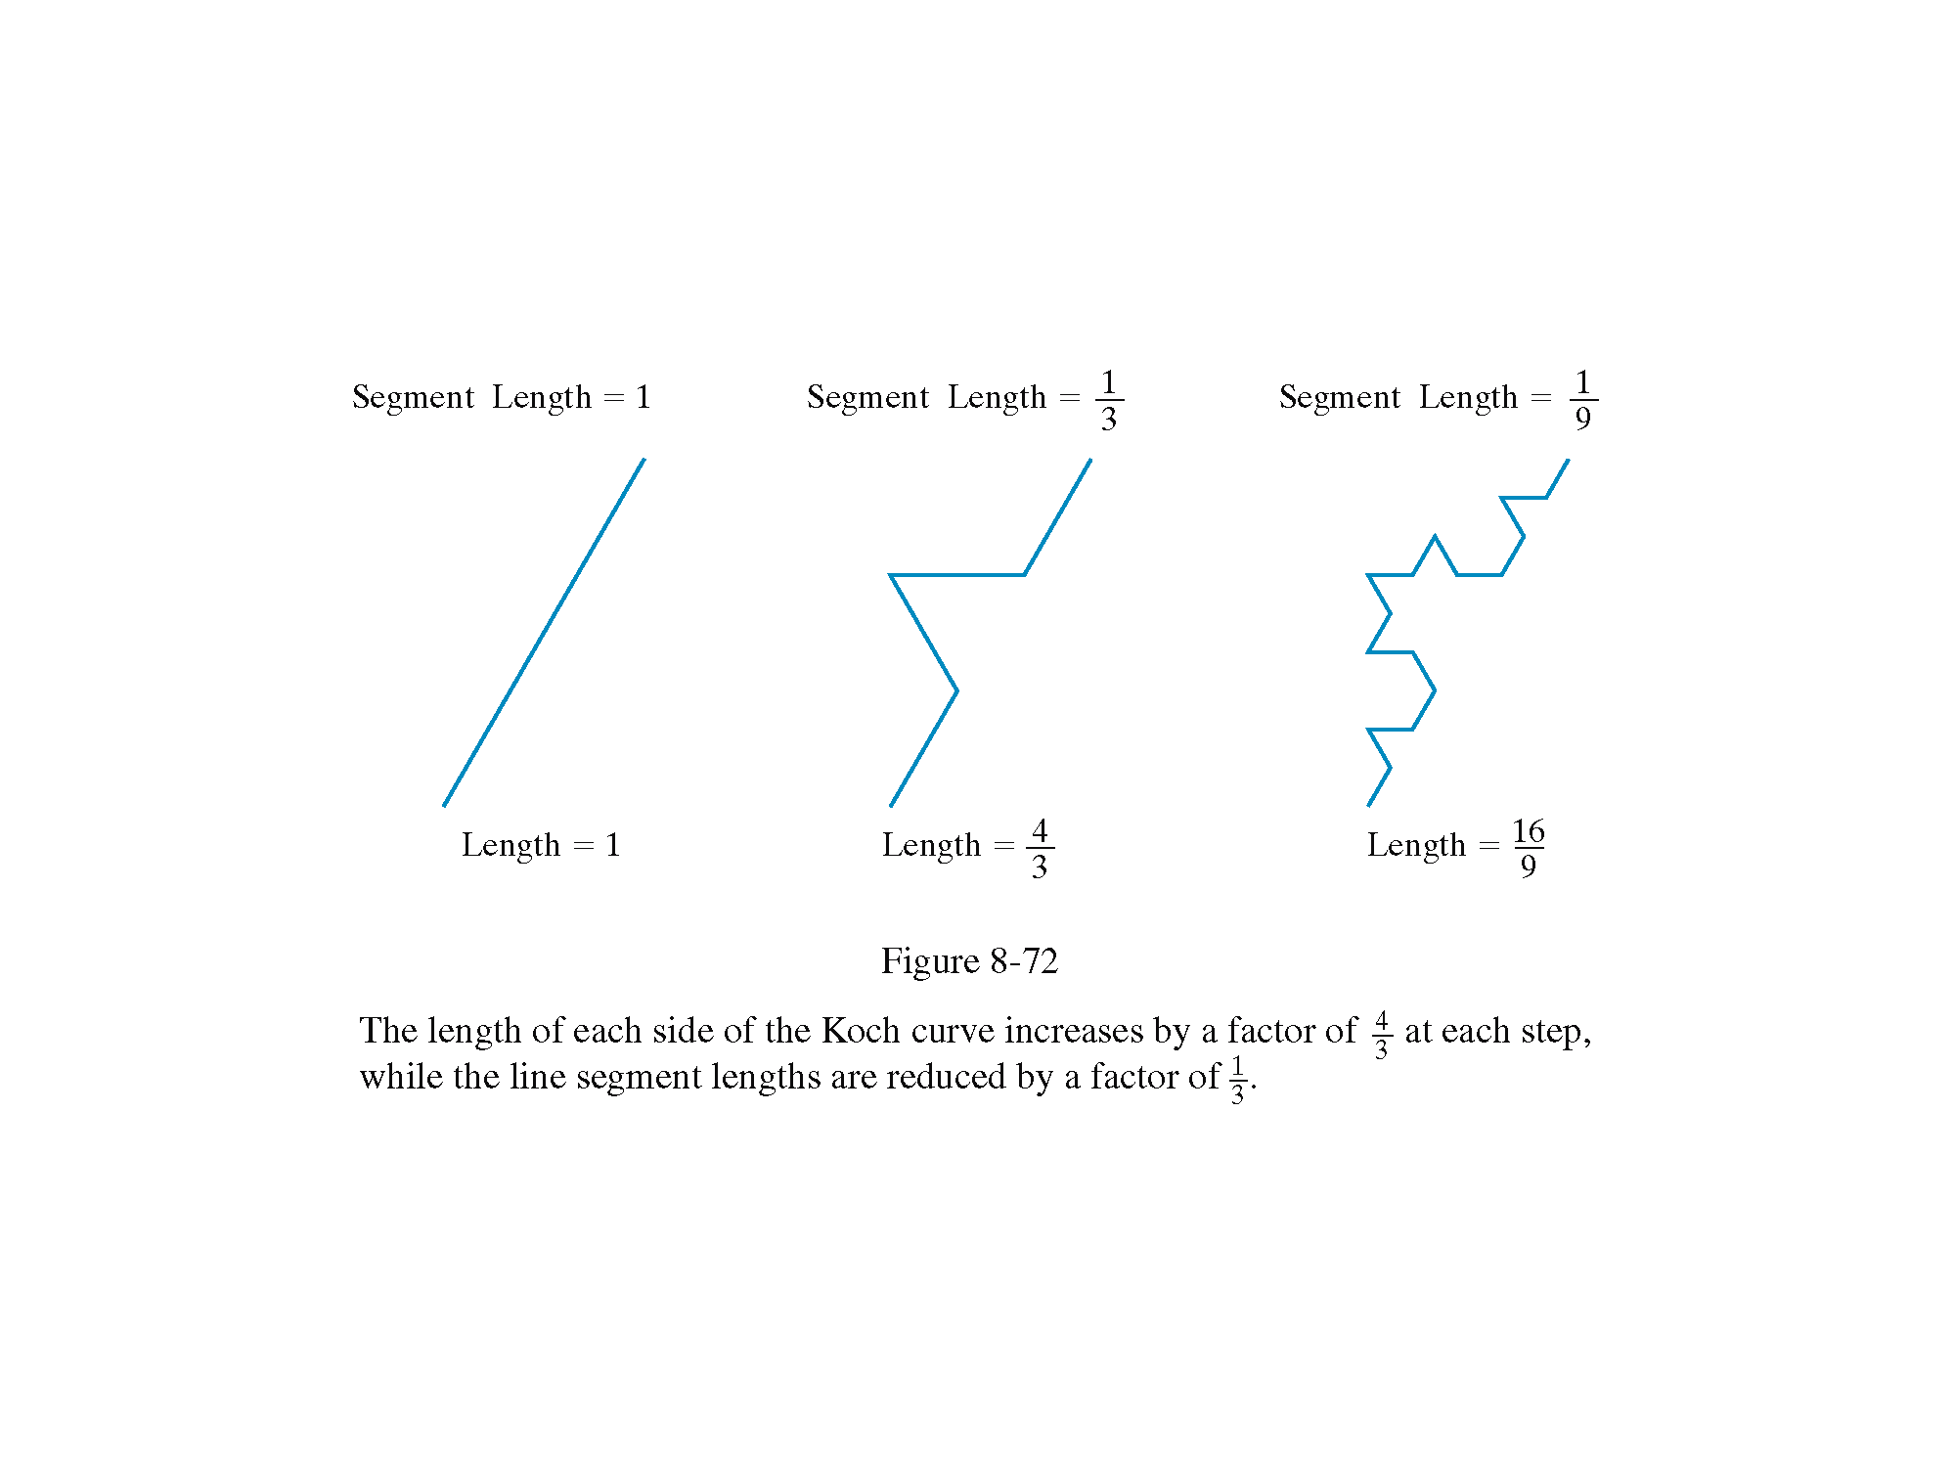
Example: The Koch Snowflake

Slide 8
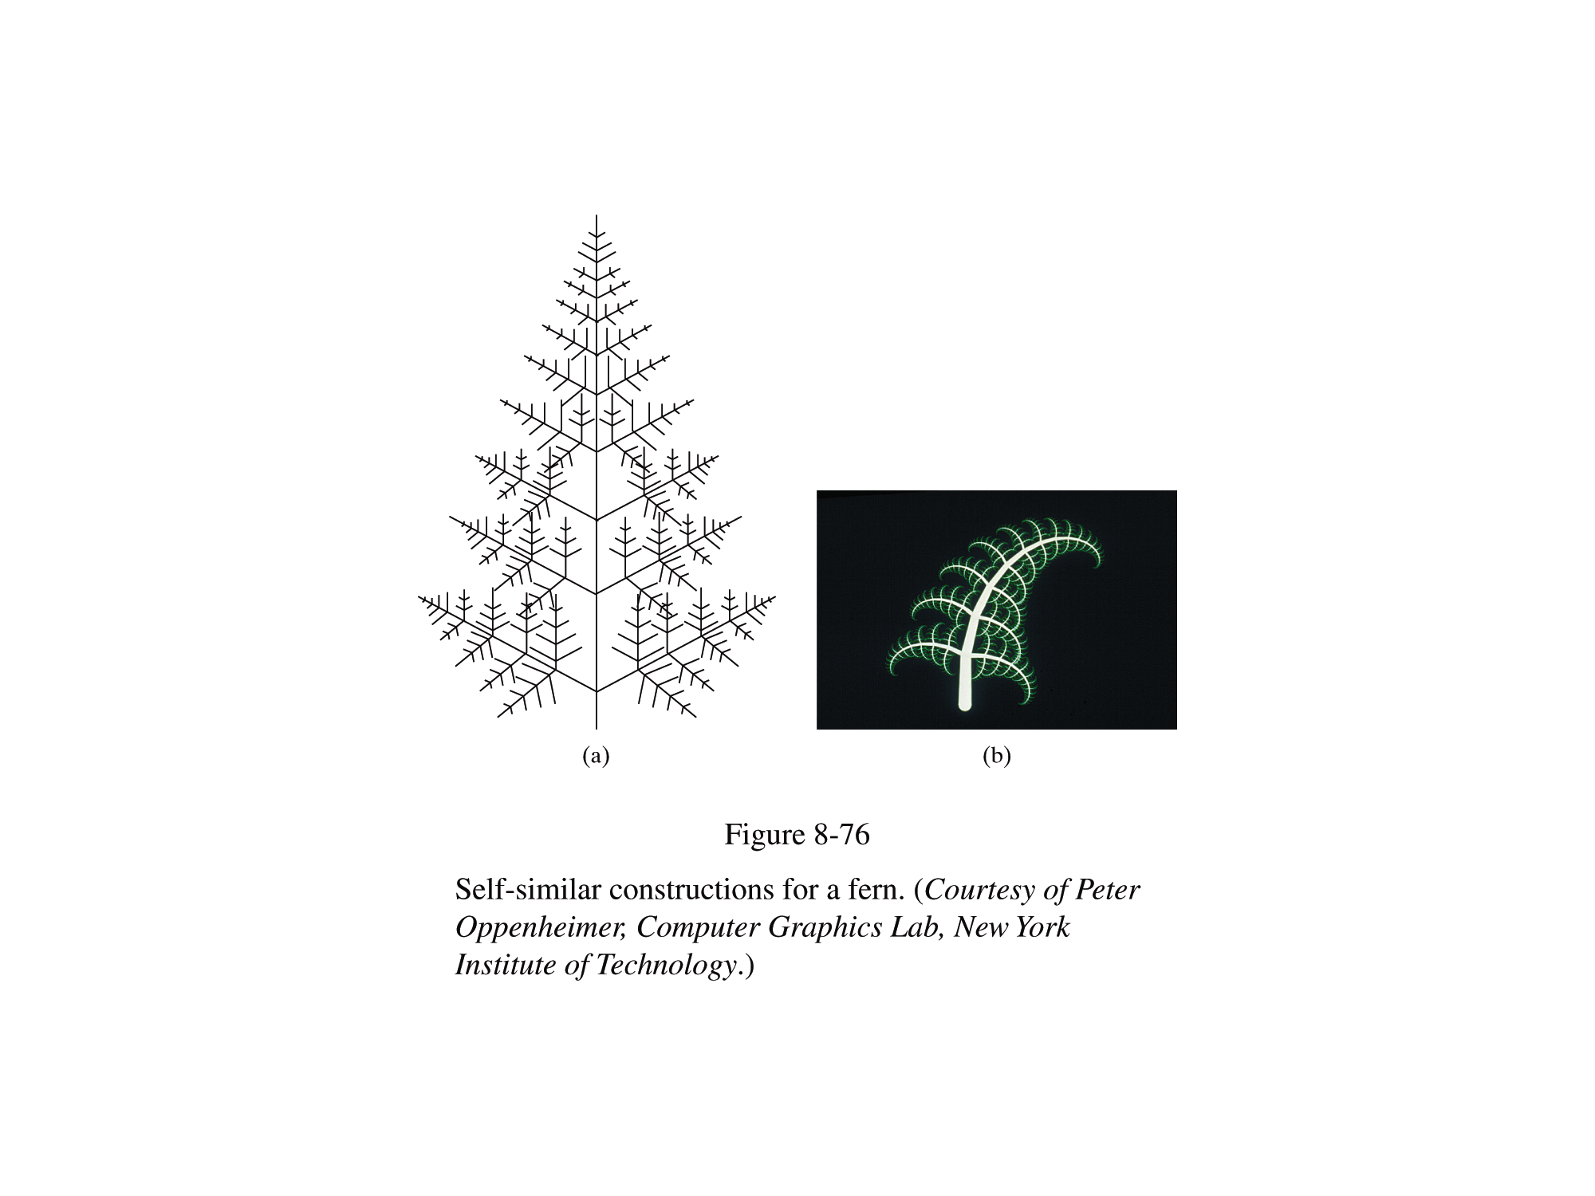
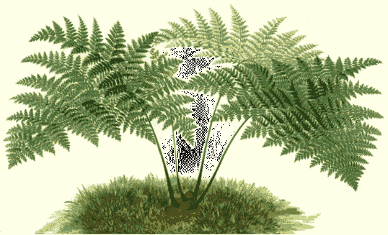
Example: Ferns
Very similar techniques can be used to generate vegetation

Slide 9
Fractal Dimension
The amount of variation in the structure of a fractal object is described as the fractal dimension, D
  More jagged looking objects have larger fractal dimensions
Calculating the fractal dimension can be difficult, especially for particularly complex fractals

Slide 10
Types Of Fractals
Fractals can be classified into three groups
  Self similar fractals
    These have parts that are scaled down versions of the entire object
    Commonly used to model trees, shrubs etc
  Self affine fractals
    Have parts that are formed with different scaling parameters in each dimension
    Typically used for terrain, water and clouds
  Invariant fractal sets
    Fractals formed with non-linear transformations
    Mandelbrot set, Julia set – generally not so useful

Slide 11
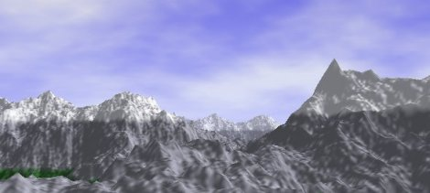
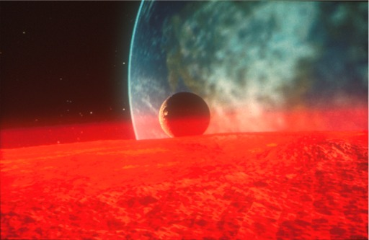
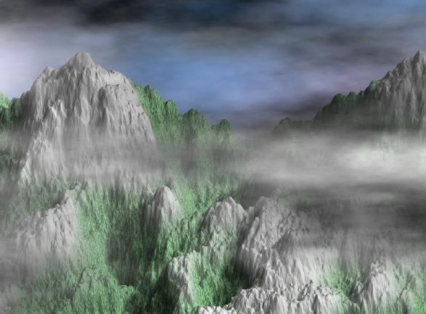
Random Midpoint Displacement Methods For Topography
One of the most successful uses of fractal techniques in graphics is the generation of landscapes
One efficient method for doing this is random midpoint displacement

Slide 12
Random Midpoint Displacement Methods For Topography (cont…)
Easy to do in two dimensions
Easily expanded to three dimensions to generate terrain
Can introduce a roughness factor H to control terrain appearance
Control surfaces can be used to start with a general terrain shape

Slide 13
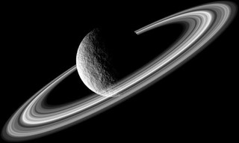
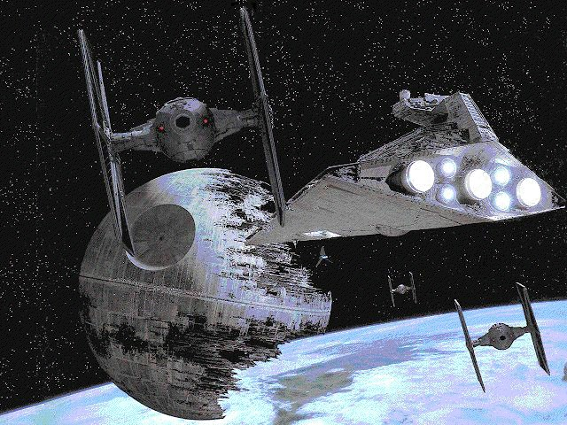
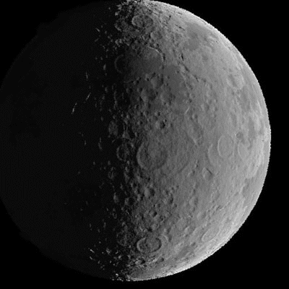
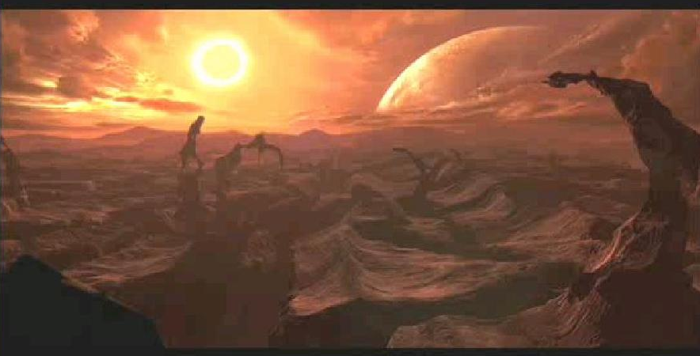
Fractals In Film Special Effects

Slide 14
Geometric Construction of Deterministic Self-Similar Fractals
To geometrically construct a deterministic (nonrandom) self-similar
fractal, we start with a given geometric shape, called the initiator.
Subparts of the initiator are then replaced with a pattern, called the
generator.
Koch Curve
1. Begin with a line segment
2. Divide it into thirds i.e. scaling factor = 1/3 and replace the center third by the two adjacent sides of an equilateral triangle
3. There are now 4 equal length segments each 1/3 the original length , so the new curve has 4/3 length of the original length

Slide 15

Geometric Construction of Deterministic Self-Similar Fractals
5. Repeat the process for each of the four segments
6. The cure has gained more wiggles and its length now is 16/9 times the original
7. Repeat this indefinitely and the length every time increases by 4/3 factor. The curve will be infinite but is folded in lots of tiny wiggles
8. Its topological dimension is 1 and it’s Fractal dimension can be calculated as follows
We have to assemble 4 such curves to make the original curve so
N = 4 and Scaling factor S = 3 as each segment has 1/3 the original segment length
So the fractal dimension is D = ( log 4) / ( log (3)) = 1.2618

Slide 16

Geometric Construction of Deterministic Self-Similar Fractals
Peano Curve
It is also called space filling curve and is used for filling two dimensional
object e.g. a square
Steps to generate a Peano curve
1. Sub-divide a square into 4 quadrants and draw the curve which connects the center points of each
2. Further subdivide each of the quadrants and connect the centers of each of these finer divisions before moving to the next major quadrant
3. The third approximation subdivides again it again connects the centers of the finest level before stepping to the next level of detail
The Fractal dimension of the curve:
At each subdivision the scale changes by 2 but length changes by 4
For the square it takes 4 curves of half scale to build the full sized object so the Dimension is given by
D = ( log 4) / ( log (2))
So, the Fractal Dimension is 2 and Topological Dimension is 1

Slide 17
3D Clipping
2D Clipping : window is considered as a clipping boundary
3D : a view volume is considered, which is a box between the two planes, the front and the back plane
The part of the object which lies inside the view volume will be displayed and the part that lies outside will be clipped
Cohen Sutherland ‘s region code approach can be extended for 3D clipping as well
In 2D, a point is checked if it is inside the visible window/region or not but in 3D clipping a point is compared against a plane

Slide 18
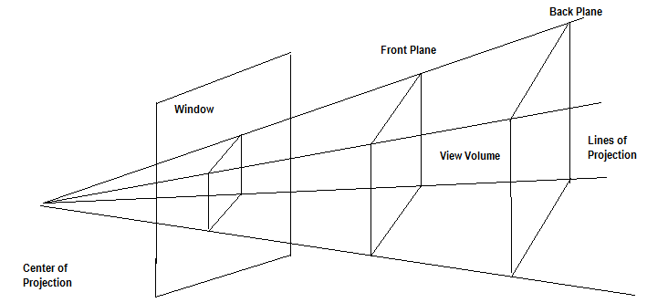
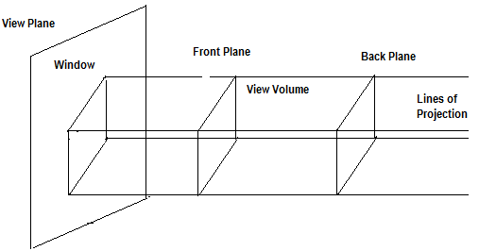
3D Clipping
For a parallel projection a box or a region is a rectangular area and in case of perspective projection it is a truncated pyramidal volume called a frustum of vision
The view volume has 6 sides: Left, Right , Bottom, Top, Near and Far

Slide 19
3D Clipping
Here six bits are used to denote the region code
The bits are set to 1 as per the following rule:
Bit 1 is set to 1 if x < x_{vmin} Bit 2 is set to 1 if x > x_{vmax}
Bit 3 is set to 1 if y < y_{vmin} Bit 4 is set to 1 if y > y_{vmax}
Bit 5 is set to 1 if z < z_{vmin} Bit 6 is set to 1 if z > z_{vmax}
If both the end points have region codes 000000 then the line is completely visible
If the logical AND of the two end points region codes are not 000000 i.e. the same bit position of both the end points have the value 1, then the line is completely rejected or invisible else it is the case of partial visibility so the intersections with the planes must be computed

Slide 20
3D Clipping
For a line with end points P₁ (x₁,y₁,z₁) and P₂ (x₂,y₂,z₂), the parametric equation can be expressed as:
x= x₁ + (x₂ – x₁) u y= y₁ + (y₂ – y₁) u z= z₁ + (z₂ – z₁) u
If we are testing a line against the front plane of the viewport then z = z_{vmin} and u = (z_{vmin} –z₁)/(z₂ –z₁)
therefore
x_{i}= x₁ + (x₂ – x₁) {(z_{vmin} –z₁)/(z₂ –z₁)}
y_{i}= y₁ + (y₂ – y₁) {(z_{vmin} –z₁)/(z₂ –z₁)}
where x_{i} and y_{i} are the intersection points with the plane

Slide 21
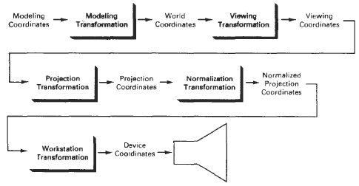
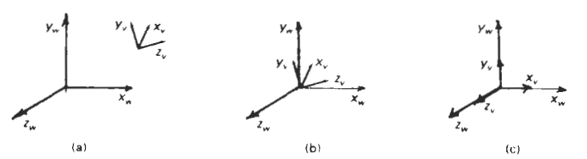
3D Viewing Transformation
Mapping positions within a rectangular view volume to a three-dimensional rectangular viewport is accomplished with a combination of scaling and translation, similar to the operations needed for a two-dimensional window-to viewport mapping.
,

Slide 22
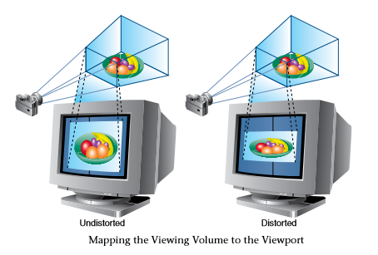
3D Viewing Pipeline

Slide 23
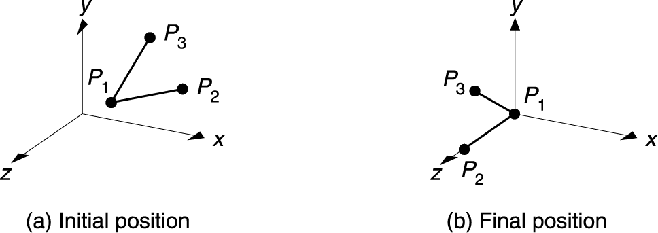
Example: Composition of 3D Transformations
Goal: Transform P₁P₂ and P₁P₃
1994 Foley/VanDam/Finer/Huges/Phillips ICG

Slide 24
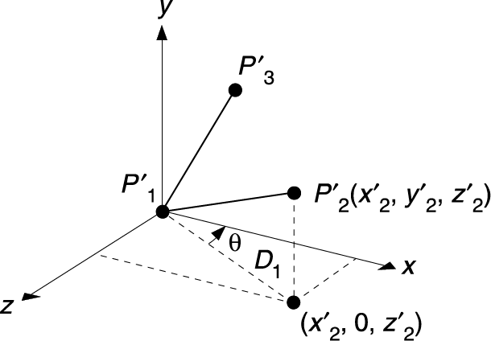
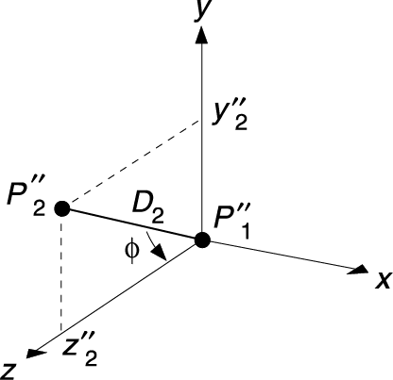
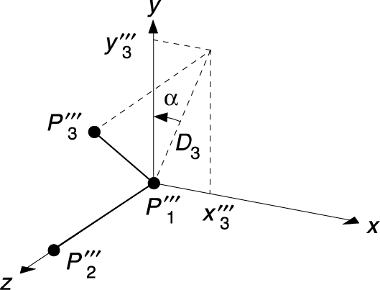
Example (Cont.)
(1)
Process
  Translate P₁ to (0,0,0)
  Rotate about y
  Rotate about x
  Rotate about z
(2-3)
(4)
1994 Foley/VanDam/Finer/Huges/Phillips ICG

Slide 25
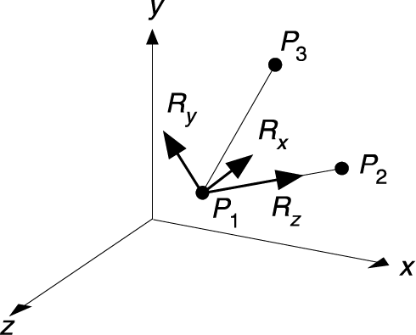
Final Result
What we’ve really done is transform the local coordinate system R_{x}, R_{y}, R_{z}
to align with the origin x,y,z
1994 Foley/VanDam/Finer/Huges/Phillips ICG

Slide 26
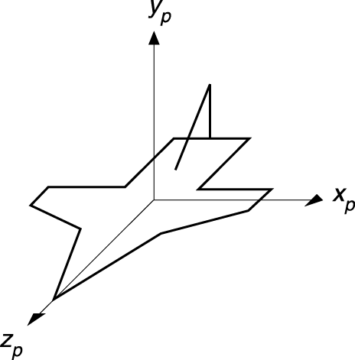
Example 2: Composition of 3D Transformations
Airplane defined in x,y,z
Problem: want to point it in Dir of Flight (DOF)
centered at point P
Note: DOF is a vector
Process:
  Rotate plane
  Move to P
1994 Foley/VanDam/Finer/Huges/Phillips ICG

Slide 27
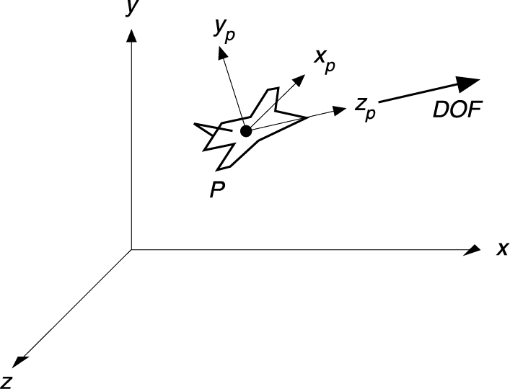
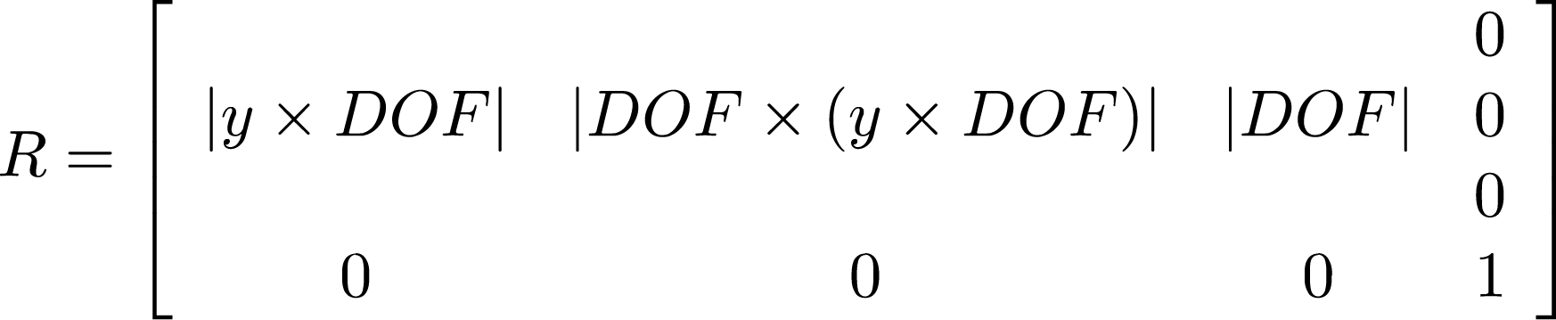
Example 2 (cont.)
Z_{p} axis to be DOF
X_{p} axis to be a horizontal vector perpendicular to DOF
  y x DOF
Y_{p}, vector perpendicular to both Z_{p} and X_{p} (i.e.Z_{p} x X_{p})
1994 Foley/VanDam/Finer/Huges/Phillips ICG

Slide 28


